Slide 1

7th Grade Math
Unit 7, Lesson 10 Calculating Percent Error Volume 1, pg. 344

Slide 2


Benchmark
MA.7.AR.3.1
Apply previous understanding of percentages and ratios to solve multi-step, real-world percent problems.
volume 1, pg. 344

Slide 3
Integrated Mathematical Thinking and Reasoning Standards
MA.K12.MTR.3.1 Complete tasks with mathematical fluency.
MA.K12.MTR.6.1 Assess the reasonableness of solutions.
MA.K12.MTR.7.1 Apply mathematics to real-world contexts.
volume 1, pg. 344

Slide 4

Learning Target
I can find percent error.
volume 1, pg. 344

Slide 5

Warm-Up
volume 1, pg. 344

Slide 6
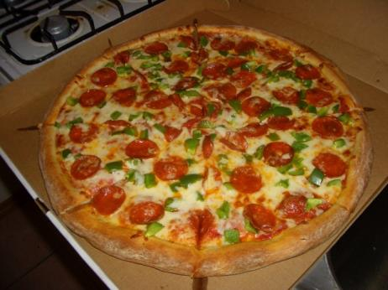
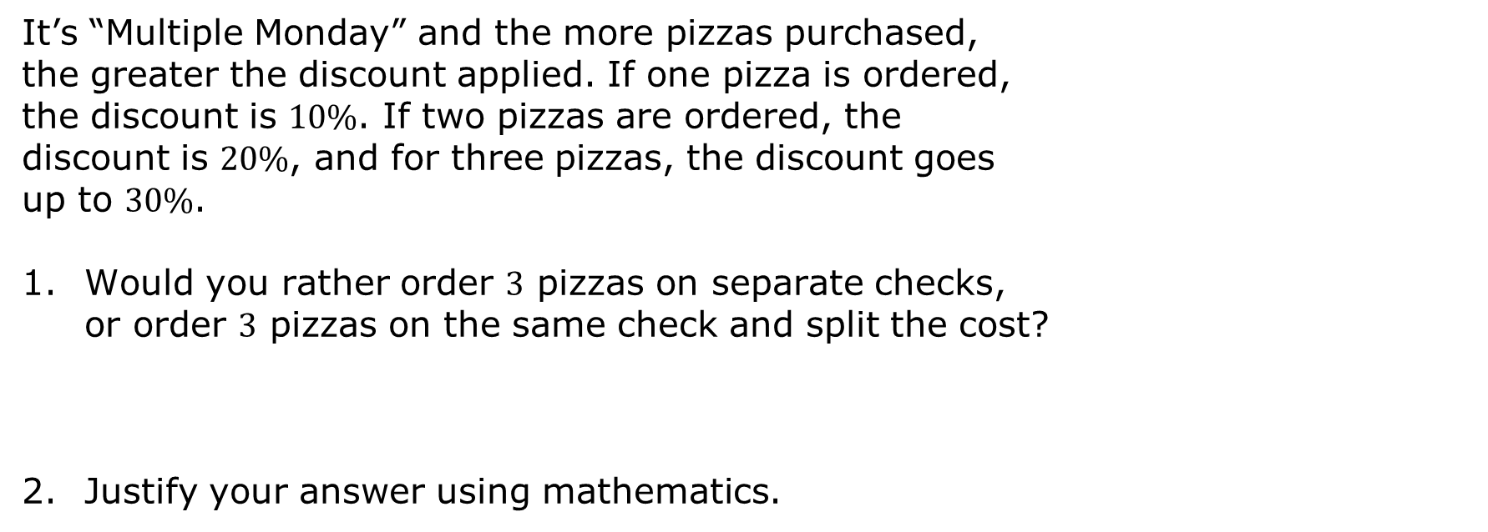
7.10.1 Warm-Up: Would You Rather?
It’s “Multiple Monday” and the more pizzas purchased, the greater the discount applied. If one pizza is ordered, the discount is $10\%$. If two pizzas are ordered, the discount is $20\%$, and for three pizzas, the discount goes up to $30\%$.
Would you rather order 3 pizzas on separate checks, or order $3$ pizzas on the same check and split the cost?
Justify your answer using mathematics.
volume 1, pg. 344

Slide 7

Exploration
volume 1, pg. 345

Slide 8

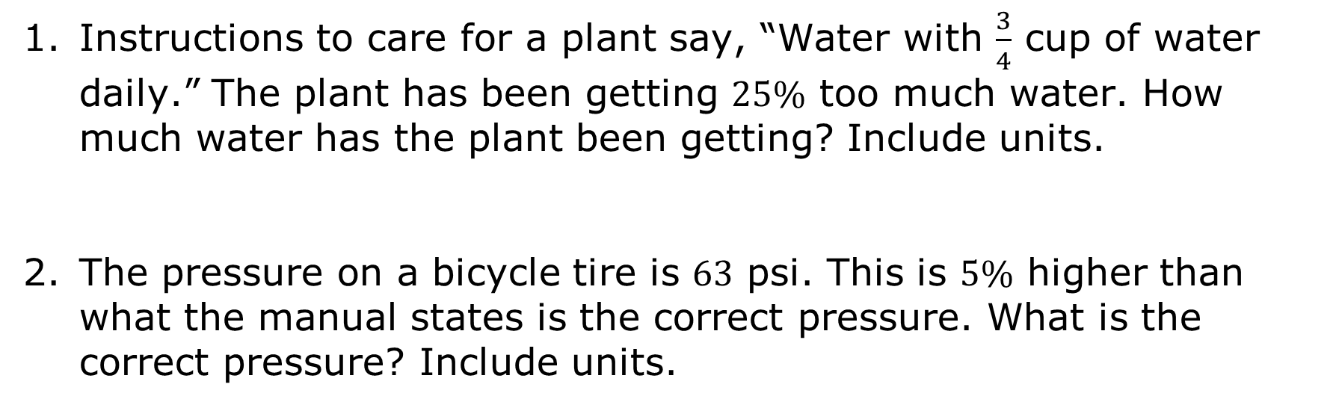
7.10.2 Exploration: Estimate vs. Actual
Instructions to care for a plant say, “Water with $\frac{3}{4}$ cup of water daily.” The plant has been getting $25\%$ too much water. How much water has the plant been getting? Include units.
The pressure on a bicycle tire is $63$ psi. This is $5\%$ higher than what the manual states is the correct pressure. What is the correct pressure? Include units.
volume 1, pg. 345

Slide 9
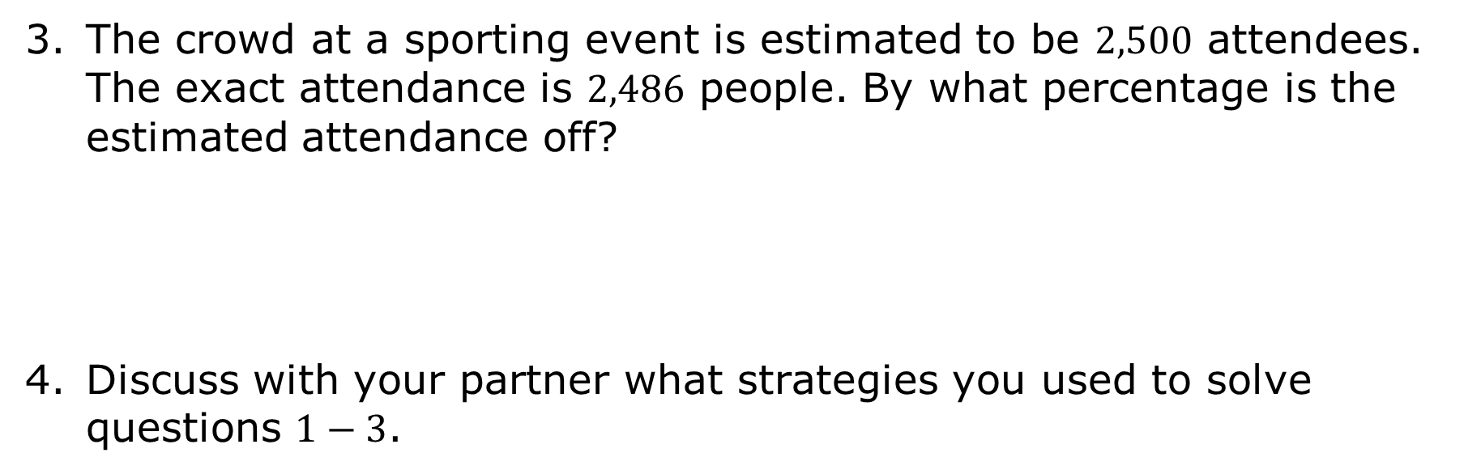
The crowd at a sporting event is estimated to be $2,500$ attendees. The exact attendance is $2,486$ people. By what percentage is the estimated attendance off?
Discuss with your partner what strategies you used to solve questions $1−3$.
volume 1, pg. 345

Slide 10

Guided Instruction
volume 1, pg. 345

Slide 11

7.10.3 Guided Instruction: Percent Error
Percent error is the difference between the estimated number and the actual number as a percentage of the actual value.
Percent error can be used to describe any situation where there is a correct value and an incorrect value, and to describe the relative difference between them.
volume 1, pg. 345

Slide 12
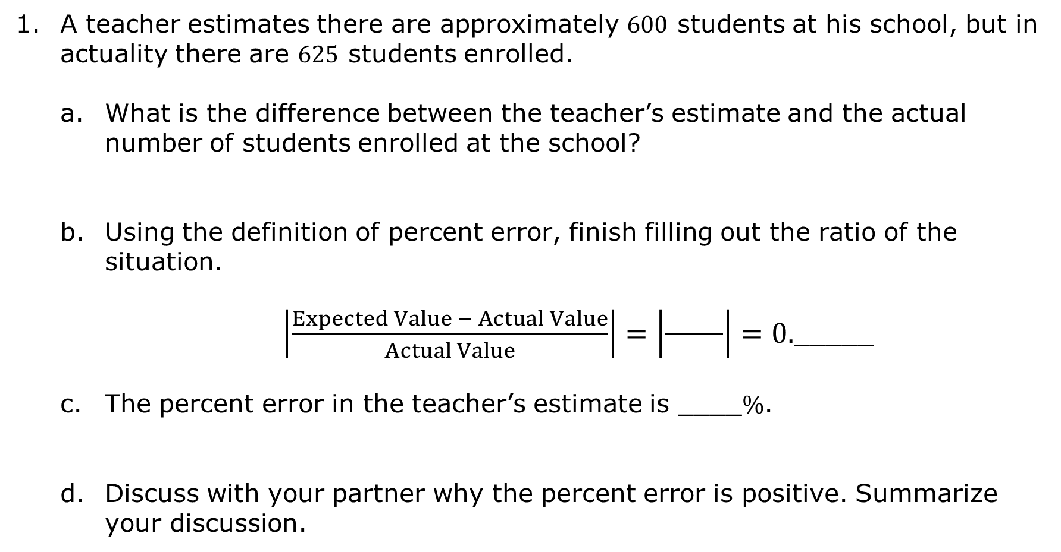
A teacher estimates there are approximately $600$ students at his school, but in actuality there are $625$ students enrolled.
What is the difference between the teacher’s estimate and the actual number of students enrolled at the school?
Using the definition of percent error, finish filling out the ratio of the situation.
$\left|\frac{Expected Value − Actual Value}{Actual Value}\right|=\left|\frac{ }{ }\right|=0.$_____
The percent error in the teacher’s estimate is ____$\%$.
Discuss with your partner why the percent error is positive. Summarize your discussion.
volume 1, pg. 345

Slide 13
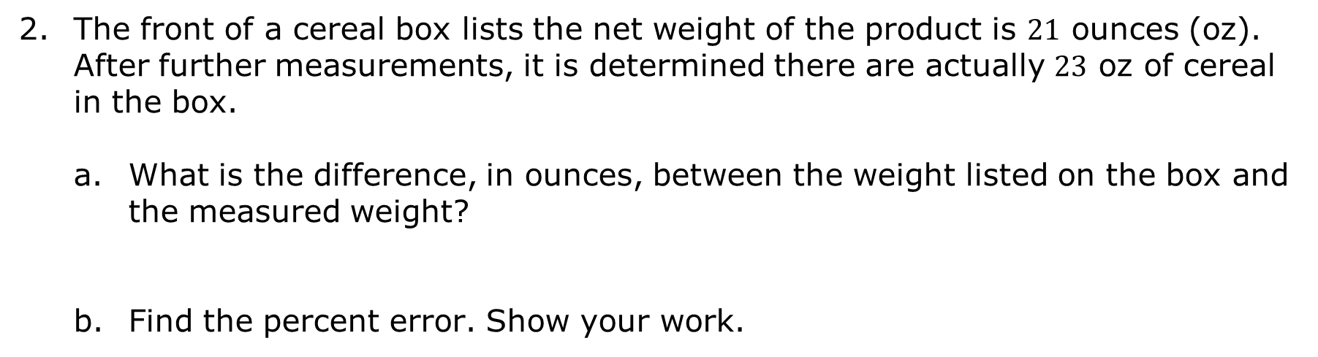
The front of a cereal box lists the net weight of the product is $21$ ounces (oz). After further measurements, it is determined there are actually $23$ oz of cereal in the box.
What is the difference, in ounces, between the weight listed on the box and the measured weight?
Find the percent error. Show your work.
volume 1, pg. 346

Slide 14

Guided Practice
volume 1, pg. 346

Slide 15

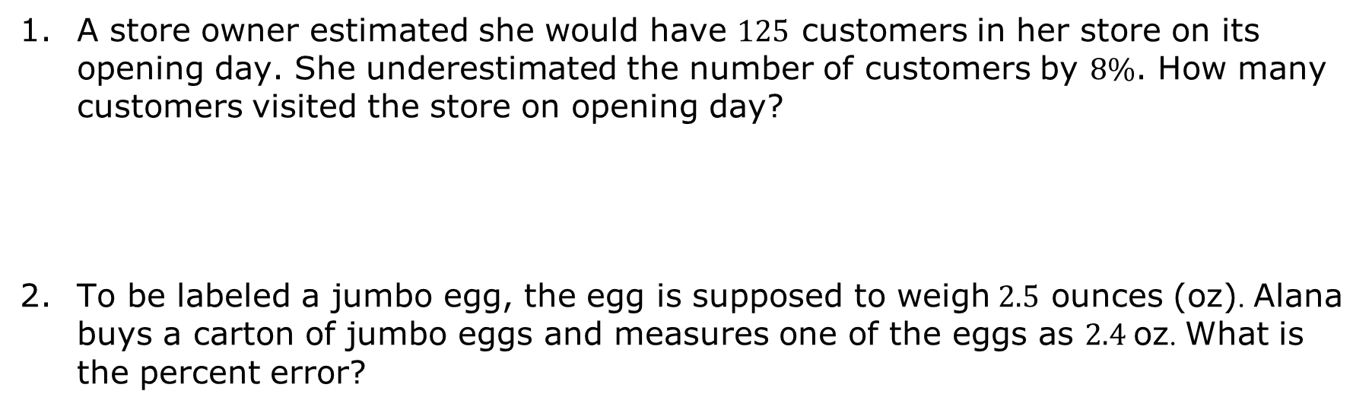
7.10.4 Guided Practice: Percent Error
A store owner estimated she would have $125$ customers in her store on its opening day. She underestimated the number of customers by $8\%$. How many customers visited the store on opening day?
To be labeled a jumbo egg, the egg is supposed to weigh $2.5$ ounces (oz). Alana buys a carton of jumbo eggs and measures one of the eggs as 2.4 oz. What is the percent error?
volume 1, pg. 346

Slide 16
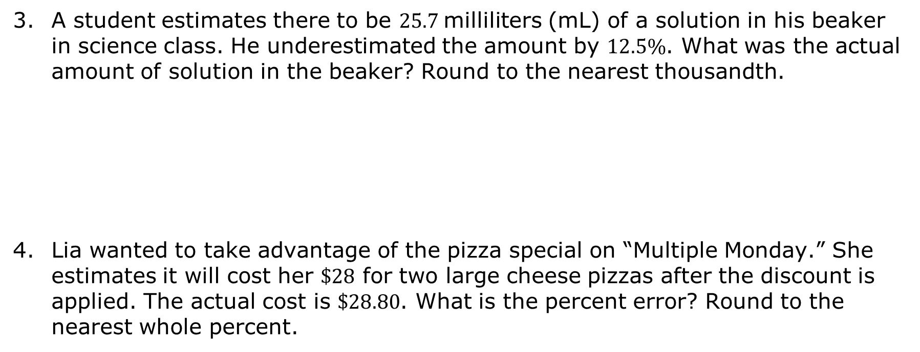
A student estimates there to be $25.7$milliliters (mL) of a solution in his beaker in science class. He underestimated the amount by $12.5\%$. What was the actual amount of solution in the beaker? Round to the nearest thousandth.
Lia wanted to take advantage of the pizza special on “Multiple Monday.” She estimates it will cost her $\$28$ for two large cheese pizzas after the discount is applied. The actual cost is $\$28.80$. What is the percent error? Round to the nearest whole percent.
volume 1, pg. 347

Slide 17

Your Turn
volume 1, pg. 347

Slide 18
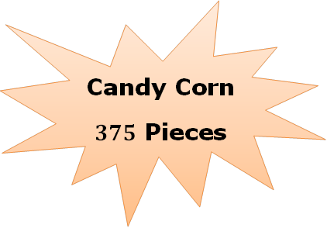
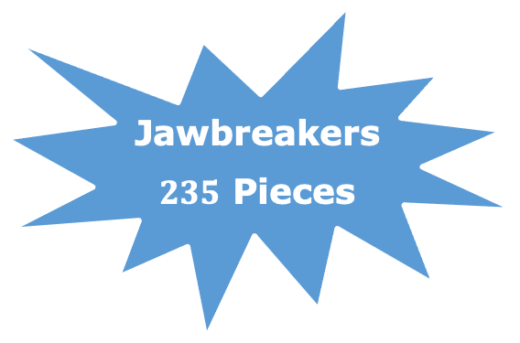
7.10.5 Your Turn!
A booth at the local carnival had various jars of candy that carnival-goers could win. Carnival-goers had to estimate the number of pieces of candy that were in the jar, with the closest estimate winning the prize. Brynn’s guess for the jar of candy corn was 303 pieces, and Cale’s guess for the jar of jawbreakers was 187. The actual number of candies in each jar are shown.
Jawbreakers
$235$ Pieces
volume 1, pg. 347

Slide 19
Use percent error to explain whose guess was closest, relative to the number of candies in the jar.
A student estimated it would take 3 hours to write a book report, but it took her 5 hours. What is the percent error for her estimate? Round to the nearest tenth.
It took 48 minutes to drive downtown. An app estimated it would be less than that. If the error was 20%, what was the app’s estimate?
volume 1, pg. 347

Slide 20

Wrap-Up
volume 1, pg. 348

Slide 21
7.10.6 Wrap-Up: Reflection
In this unit, you have learned multiple concepts about percentages and proportional relationships, including those listed below.
Showing the relationship between angle measure and the amount of a circle
Finding the area of a sector in a circle
Constructing and interpreting a circle graph
Solving discount, markup, tax, tip, and fees problems
Finding percentage of increase and decrease
Finding percent error
volume 1, pg. 348

Slide 22
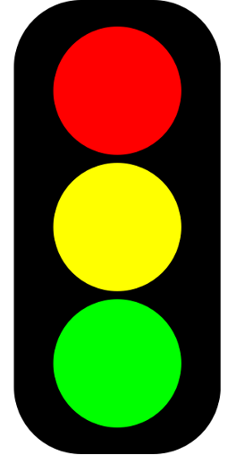
Use the stoplight reflection below to share how you are feeling about each of the concepts at this point.
I still feel stuck on how to …
I’m starting to get the hang of …
I feel confident and ready to go with …
volume 1, pg. 348

